Slide 1
Onboarding in OMS
Getting the job done with Azure Automation

Slide 2

Consultant
stijn.callebaut@inovativ.be
@stijnca
Notes:
Stijn Callebaut
Consultant at Inovativ,
Specializing in System Center Service Manager and Azure (Automation) with a love for PowerShell

Slide 3
agenda
Position Azure Automation within OMS
Provide an overview of Azure Automation capabilities
Runbooks and Assets
Security
Configuration management

Slide 4
Azure Automation!?
Is part of something larger, called OMS
Used to automate processes
Enables configuration management
Talks to any cloud or on-premises infrastructure

Slide 5
What makes up Azure Automation?
Runbooks
(scripts, workflows and graphical)
Assets
(Modules, variables, credentials, certificates, connections and schedules)
Hybrid workers
Jobs
Configurations
(DSC Configurations, DSC Node configurations and DSC nodes)
= Automation Account

Slide 6
Demo: Automation resources

Slide 7
Runbook authoring
Azure portal
Text editor
Graphical editor
PowerShell ISE
Visual studio
Visual studio code
….
Notes:
https://azure.microsoft.com/en-us/blog/announcing-azure-automation-powershell-ise-add-on/

Slide 8
Interaction
How can we interact with Azure Automation runbooks?
Via the portal (start, stop action buttons)
Using the Azure automation PowerShell module
Azure Resource Manager (ARM) API
Azure automation Schedules
Azure Alerts
Another runbook
Webhooks
Notes:
Azure alerts is currently in preview and needs to be enabled.

Slide 9
Demo: Interaction with runbooks

Slide 10
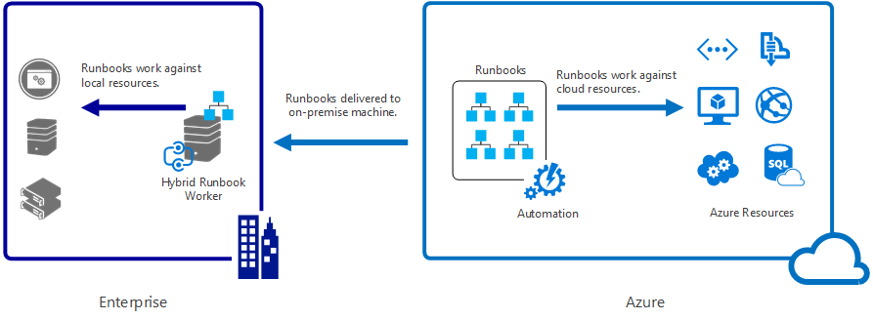
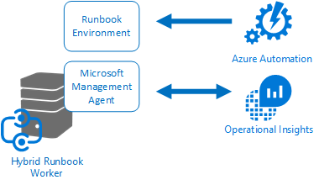
Going Hybrid
Notes:
https://azure.microsoft.com/en-us/documentation/articles/automation-hybrid-runbook-worker/
https://azure.microsoft.com/en-us/blog/azure-automation-hybrid-runbook-worker-faqs/
Execute you runbooks in another cloud or on-premises
You can have multiple workers in a worker group
Has the MMA agent installed for communications
Modules do not yet downloaded with the runbooks!

Slide 11
Demo: Hybrid runbook worker

Slide 12
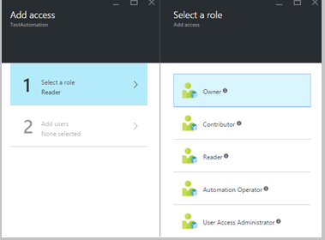
Security
Role based Access management capabilities to segregate duties
At the Automation Account level
Roles:
Owner
Contributor
Reader
Automation operator
User access administrator
Note: access is Inherited for service administrators and co-admins of a subscription and it’s Assigned for all the other users.
Notes:
Info:
https://azure.microsoft.com/en-us/documentation/articles/automation-role-based-access-control/
https://azure.microsoft.com/en-us/documentation/articles/role-based-access-built-in-roles/#automation-operator
Owner
The owner role allows access to all resources and actions within an Automation account including providing access to other users, groups and applications to manage the Automation account.
Contributor
The contributor role allows you to manage everything except modifying other user’s access permissions to an Automation account.
Reader
The reader role allows you to view all the resources in an Automation account but cannot make any changes.
Automation operator
The Automation operator role allows you to perform operational tasks such as start, stop, suspend, resume and schedule jobs. This role is helpful if you want to protect your Automation Account resources like credentials assets and runbooks from being viewed or modified but still allow members of your organization to execute these runbooks.
User access administrator
The user acess administrator role allows you to manage user access to Azure Automation accounts.
NOTE:
Subscription admins already exists as the default user. The subscription admins active directory group includes the service administrator(s) and co-administrator(s) for your Azure subscription. The Service admin is the owner of your Azure subscription and its resources, and will have the owner role inherited for the automation accounts too. This means that the access is Inherited for service administrators and co-admins of a subscription and it’s Assigned for all the other users. Click Subscription admins to view more details about their permissions.
RBAC can be managed from the portal and from PowerShell!

Slide 13
Configuration management
Azure automation DSC
Is a DSC pull server as a service
Deploy, update and monitor the desired state
Can manage any VM (Windows, Linux) in any location (Azure,AWS, on-prem,..)
Builds on top of PowerShell DSC (desired state configuration
More on DSC in a follow up session (4/4/2016)
Onboarding in OMS: Configuration Management with Azure Automation
Notes:
https://azure.microsoft.com/en-us/documentation/articles/automation-dsc-overview/

Slide 14
Q&A

